Slide 1
Office Ready Course Course
Microsoft Excel

Slide 2
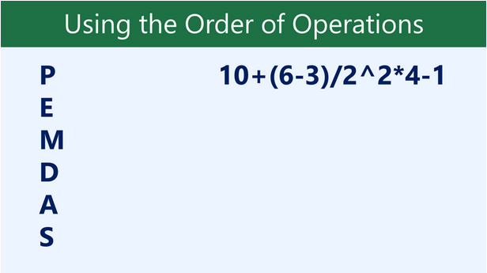
Order of Math Operation in Excel
Excel calculates formulas based on the following order of operations:
Operations enclosed in parentheses
Exponential calculations (3^2, for example)
Multiplication and division, whichever comes first
Addition and subtraction, whichever comes first
A mnemonic that can help you remember the order is PEMDAS, or Please Excuse My Dear Aunt Sally.

Slide 3
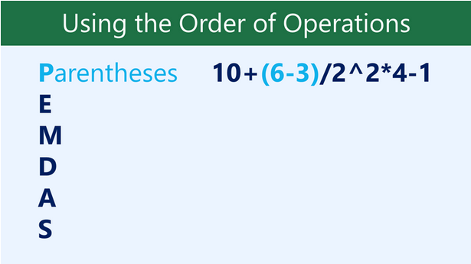
Order of Math Operation in Excel
Excel calculates formulas based on the following order of operations:
Operations enclosed in parentheses
Exponential calculations (3^2, for example)
Multiplication and division, whichever comes first
Addition and subtraction, whichever comes first
A mnemonic that can help you remember the order is PEMDAS, or Please Excuse My Dear Aunt Sally.

Slide 4
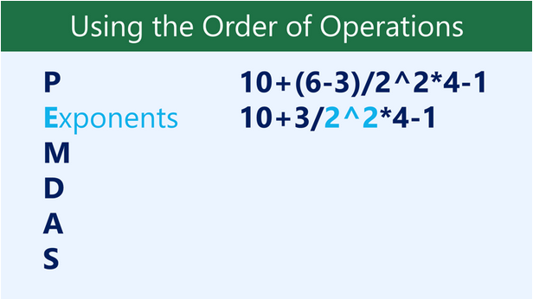
Order of Math Operation in Excel
Excel calculates formulas based on the following order of operations:
Operations enclosed in parentheses
Exponential calculations (3^2, for example)
Multiplication and division, whichever comes first
Addition and subtraction, whichever comes first
A mnemonic that can help you remember the order is PEMDAS, or Please Excuse My Dear Aunt Sally.

Slide 5
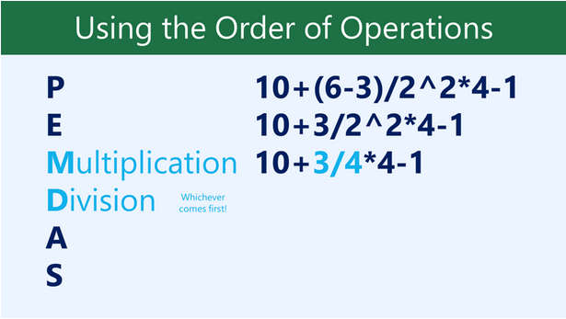
Order of Math Operation in Excel
Excel calculates formulas based on the following order of operations:
Operations enclosed in parentheses
Exponential calculations (3^2, for example)
Multiplication and division, whichever comes first
Addition and subtraction, whichever comes first
A mnemonic that can help you remember the order is PEMDAS, or Please Excuse My Dear Aunt Sally.

Slide 6
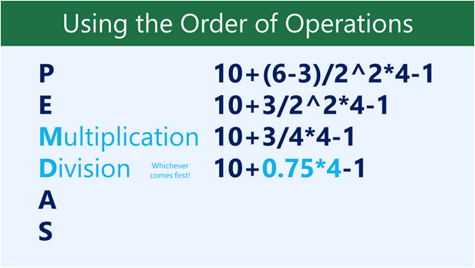
Order of Math Operation in Excel
Excel calculates formulas based on the following order of operations:
Operations enclosed in parentheses
Exponential calculations (3^2, for example)
Multiplication and division, whichever comes first
Addition and subtraction, whichever comes first
A mnemonic that can help you remember the order is PEMDAS, or Please Excuse My Dear Aunt Sally.

Slide 7
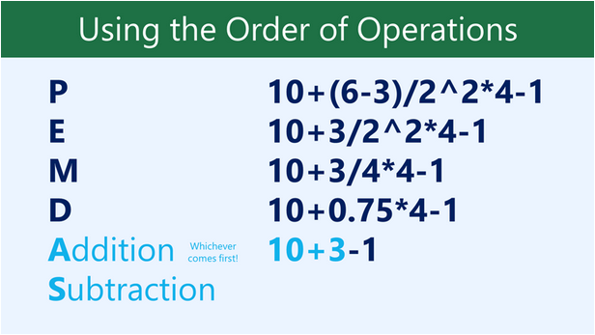
Order of Math Operation in Excel
Excel calculates formulas based on the following order of operations:
Operations enclosed in parentheses
Exponential calculations (3^2, for example)
Multiplication and division, whichever comes first
Addition and subtraction, whichever comes first
A mnemonic that can help you remember the order is PEMDAS, or Please Excuse My Dear Aunt Sally.

Slide 8
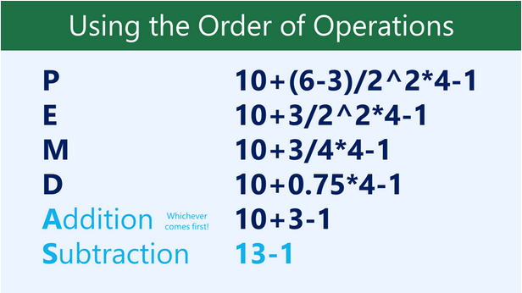
Order of Math Operation in Excel
Excel calculates formulas based on the following order of operations:
Operations enclosed in parentheses
Exponential calculations (3^2, for example)
Multiplication and division, whichever comes first
Addition and subtraction, whichever comes first
A mnemonic that can help you remember the order is PEMDAS, or Please Excuse My Dear Aunt Sally.

Slide 9
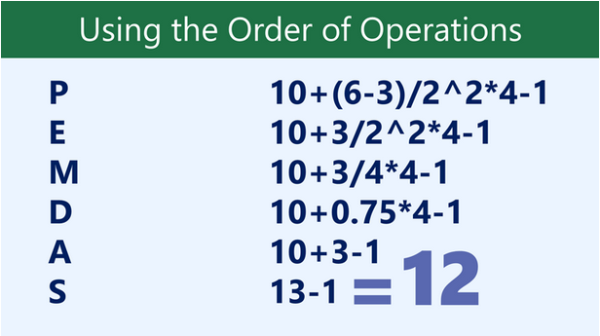
Order of Math Operation in Excel
Excel calculates formulas based on the following order of operations:
Operations enclosed in parentheses
Exponential calculations (3^2, for example)
Multiplication and division, whichever comes first
Addition and subtraction, whichever comes first
A mnemonic that can help you remember the order is PEMDAS, or Please Excuse My Dear Aunt Sally.

Slide 10
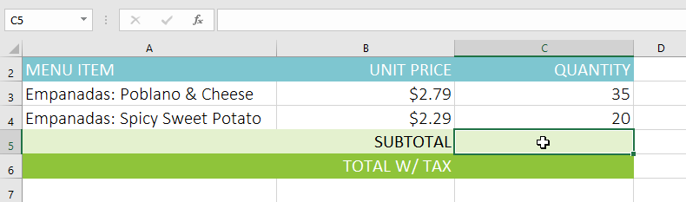
Create Formulas with Order of Operation
In the example below, we'll use cell references along with numerical values to create a complex formula that will calculate the subtotal for a catering invoice. The formula will calculate the cost of each menu item first, then add these values.
1) Select the cell that will contain the formula. In our example, we'll select cell C5.

Slide 11
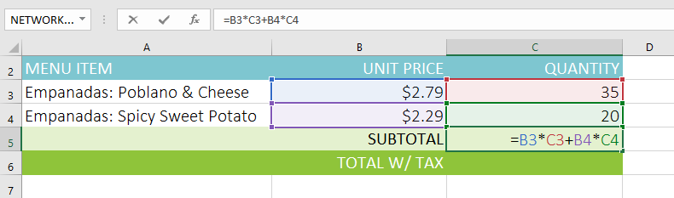
Create Formulas with Order of Operation
2) Enter your formula. In our example, we'll type =B3*C3+B4*C4. This formula will follow the order of operations, first performing the multiplication: 2.79*35 = 97.65 and 2.29*20 = 45.80. It then will add these values to calculate the total: 97.65+45.80.

Slide 12
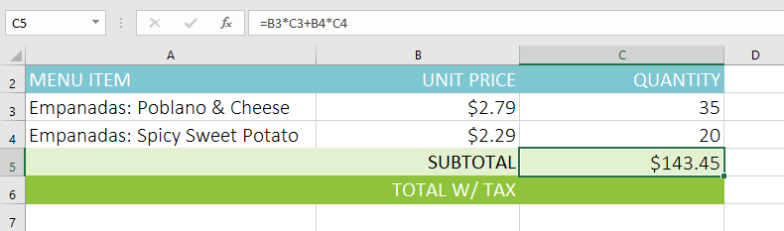
Create Formulas with Order of Operation
3) Double-check your formula for accuracy, then press Enter on your keyboard. The formula will calculate and display the result. In our example, the result shows that the subtotal for the order is $143.45.

Slide 13

Create Formulas with Order of Operation
You can add parentheses to any equation to make it easier to read. While it won't change the result of the formula in this example, we could enclose the multiplication operations within parentheses to clarify that they will be calculated before the addition.
Excel will not always tell you if your formula contains an error, so it's up to you to check all of your formulas. To learn how to do this, you can read the Double-Check Your Formulas lesson from our Excel Formulas tutorial.

Slide 14
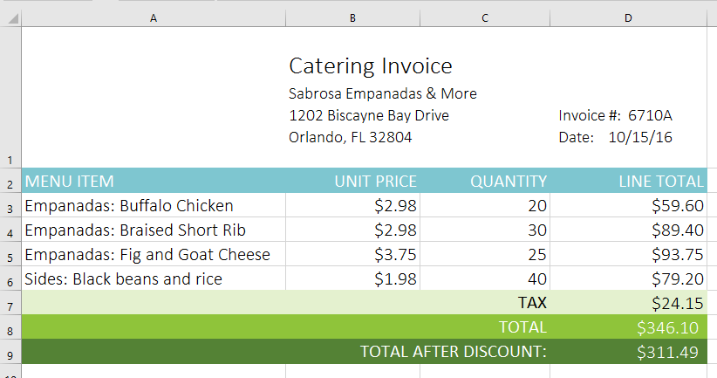
Challenge Formulas
Open our practice workbook.
Click on the Challenge tab in the bottom-left of the workbook.
In cell D7, create a formula that calculates the tax for the invoice. Use a sales tax rate of 7.5%.
In cell D8, create a formula that finds the total for the order. In other words, this formula should add cells D3:D7.
In cell D9 create a formula that calculates the total after a 10% discount. If you need help understanding how to take a percentage off of a total, check out our lesson on Discounts, Markdowns, and Sales.
When you're finished, your workbook should look like this:

Slide 15
Thank You

